Slide 1
Final Project Report
Flights Route Analysis :
Link Prediction and Optimization
Group 26

Slide 2
Group Member
Group 26
M11015018
M11015080
M11015064
陳彥家
湯傑堯
何昆霖
Flights Route Analysis
01

Slide 3
Outlines
- Dataset
- Method
- Results
- Conclusion
Flights Route Analysis
02

Slide 4
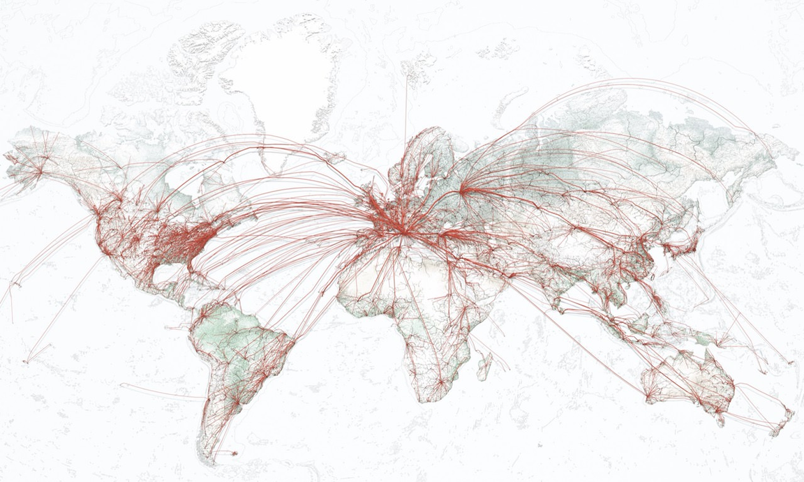


Abstract
- Airline Alliance
- Alliance Composition
Reasonable
Benefits
Potential Advantages
Flights Route Analysis
03

Slide 5
Dataset
- OpenFlight
https://openflights.org/data.html
Contents
Routes
Airports
Airlines
59036
3209
531
Flights Route Analysis
03

Slide 6
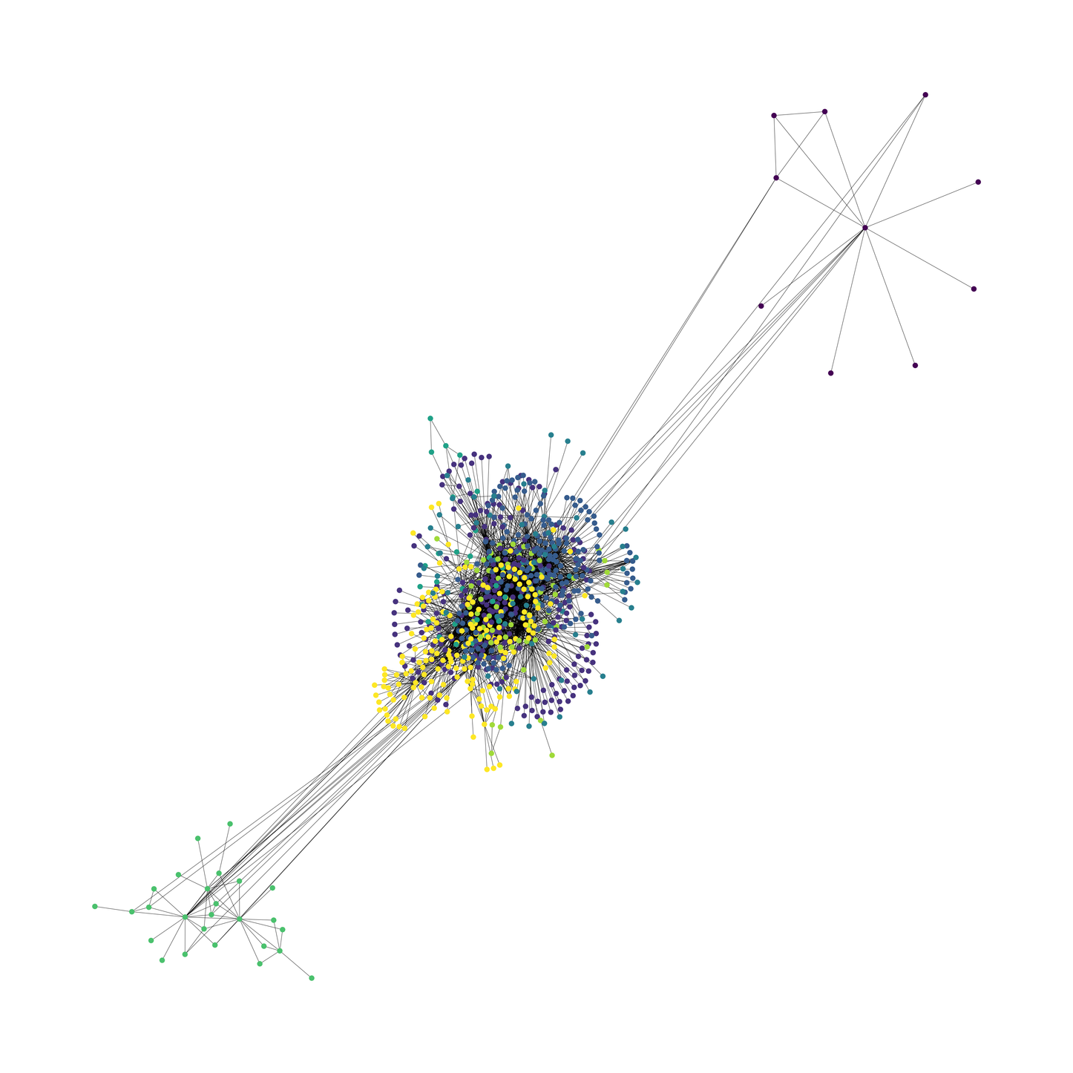
Dataset
Flights Route Analysis
03

Slide 7
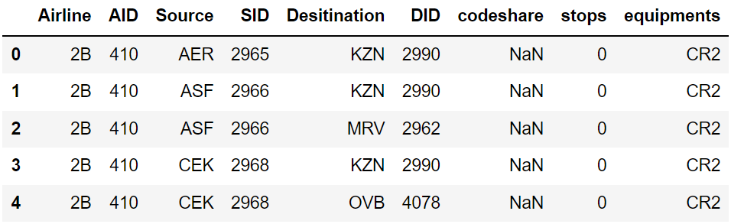
Dataset
- OpenFlight
- Routes.dat Contains the routes of airlines
Airline, AID, Source, SID, Desitination, DID, codeshare, stops, equipments
Flights Route Analysis
04

Slide 8
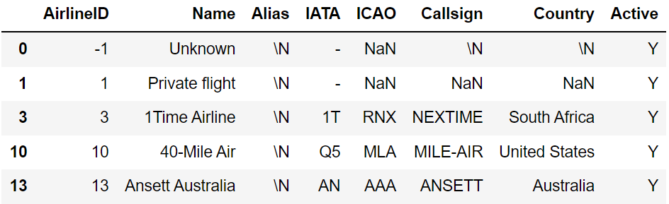
Dataset
- OpenFlight
- Airlines.dat Contains the information of airlines
Airline, Airline ID, Source Airport, Source Airport ID, Dest Airport, Dest Airport ID, Codeshare, Stops, equipment
Flights Route Analysis
05

Slide 9
Method
- 01.1 Classify airlines into their respective alliances.
- 02.1 Mapping the network according to the route of each alliance.
- 02.2 Mapping the network according to the route of each airlines.
- 03.1 Link Predction & Community Detection.
Flights Route Analysis
07

Slide 10
Method
- Airline Metric
- Cost function
- Airline analyze
Flights Route Analysis
06

Slide 11

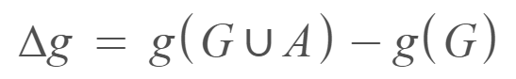
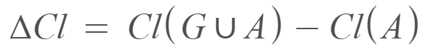
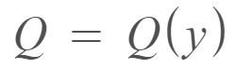
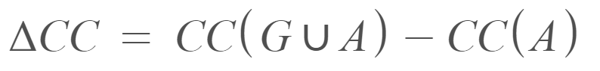
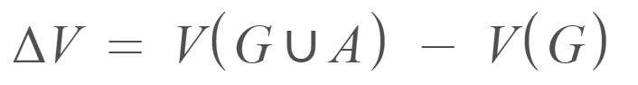
Method
Airline Metric
- number of edges in the airline
- change in effective diameter
- change in the clustering coefficient
- modularity
- change in the average closeness centrality
- change in the nodes
Flights Route Analysis
07

Slide 12
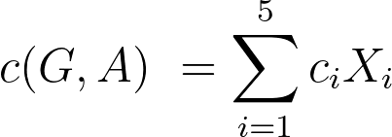
Method
Cost Function
Use CVX to find
Flights Route Analysis
08

Slide 13
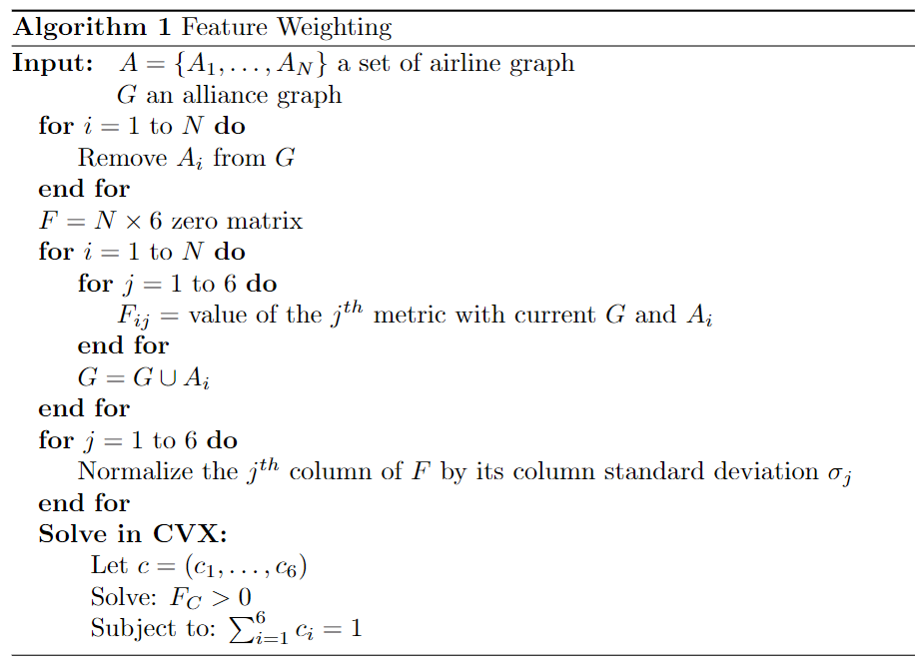
Method
Algorithm
Flights Route Analysis
09

Slide 14
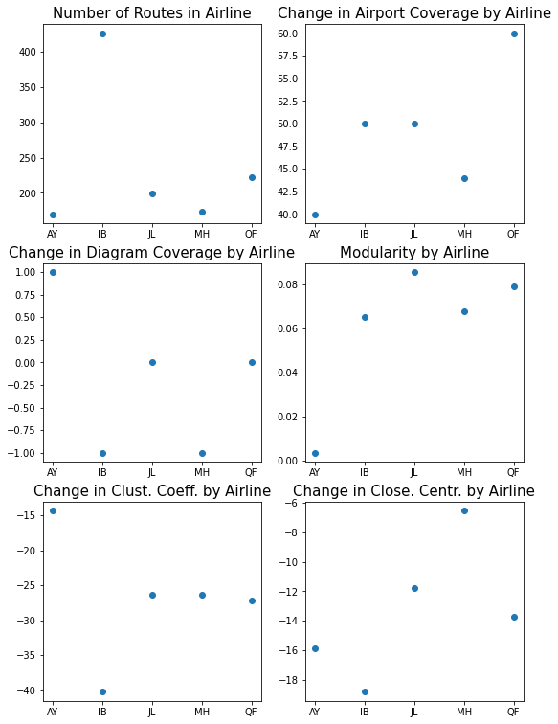
Result
One World
= (-0.001, -0.002, -0.133, 1.161, 0.005, -0.029)
10

Slide 15
Result
One World
前五推薦加入 :
代號：['7R' 'BE' 'IG' '9E' '9R']
名稱：['BRA-Transportes Aereos' 'Flybe' 'Meridiana' 'Pinnacle Airlines' 'SATENA']
= (-0.001,-0.002,-0.133,1.161,0.005,-0.029)
Flights Route Analysis
11

Slide 16
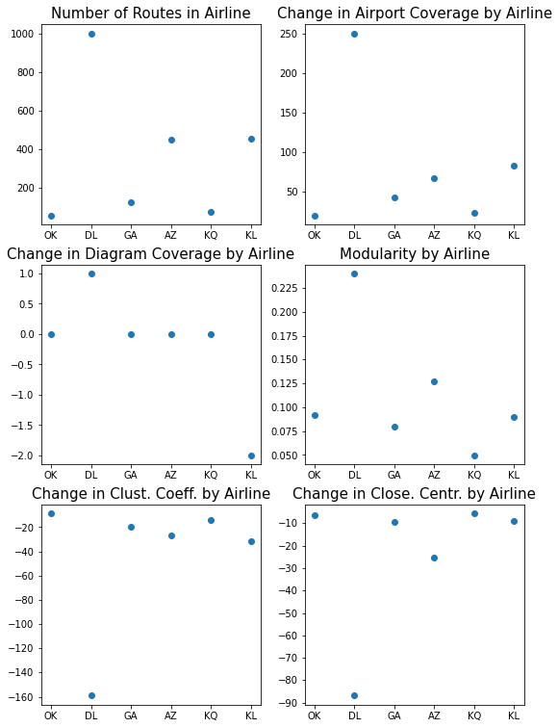
Result
Skyteam
= (0.001, -0.003, 0.148, 0.842, -0.005, 0.018)
12

Slide 17
Result
Skyteam
前五推薦加入 :
代號：['AA' 'FR' 'US' 'UA' 'CZ']
名稱：['American Airlines' 'Ryanair' 'US Airways' 'United Airlines' 'China Southern Airlines']
Flights Route Analysis
13

Slide 18
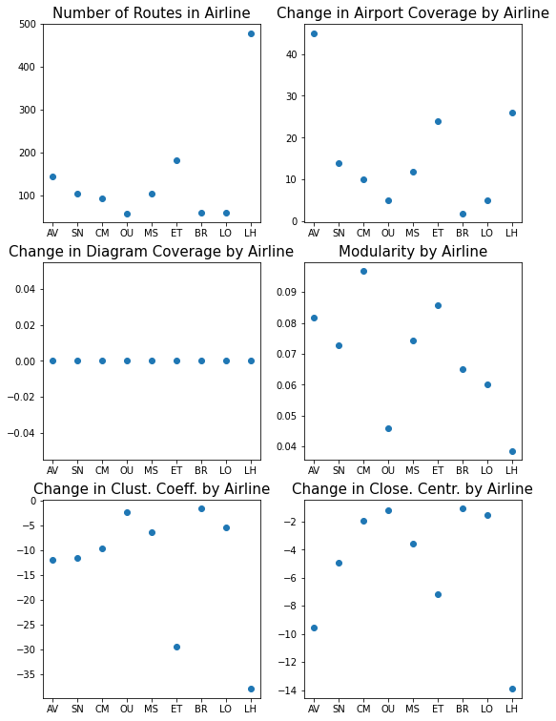
Result
Star Alliance
= (0.000, 0.000, 1.000, 0.000, -0.000, 0.000)
14

Slide 19
Result
Star Alliance
前五推薦加入 :
代號：['AB' 'GQ' 'A2' 'AD' 'FR']
名稱：['Air Berlin' 'Big Sky Airlines' 'Cielos Airlines' 'Azul' 'Ryanair']
Flights Route Analysis
15

Slide 20
Conclusion
- Each case produce the smallest magnitude coefficients
- Some alliance have similar features
- Each alliance had fewer than half of the tested airlines fail
Flights Route Analysis
16

